Slide 1



A GPS Controlled Uncrewed Aircraft Technology for Detecting and Filtering Air Pollutants Hence Purify the Air.

Slide 2

Air quality monitoring and pollution detection with Drone Technology
Introduction
Sensors and Components
Motivation
Building of drone
PRESENTATION
CONTENT
The Stages of Work till 499A
Challenges & Difficulties
Workflow
Future Plan & Conclusion

Slide 3


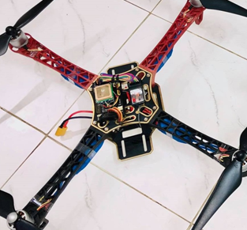

Our Multifunctional Drone
Navigate using GPS technology
Detect the air pollutants.
Monitor the level of concentartion of certain air pollutants and record the data.

Slide 4

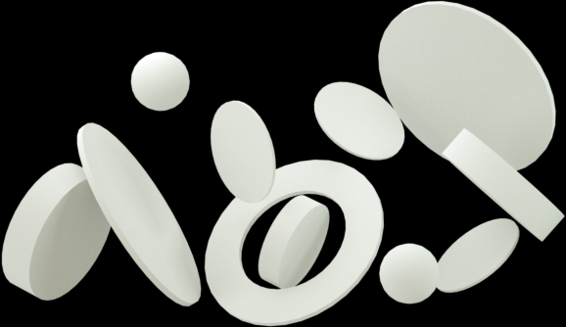
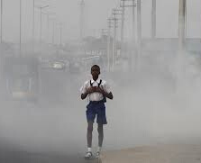
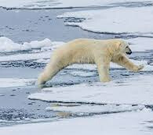
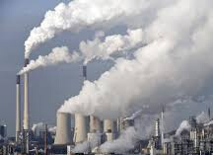
MOTIVATION
global warming
HUMAN HEALTH
ENVIRONMENT

Slide 5
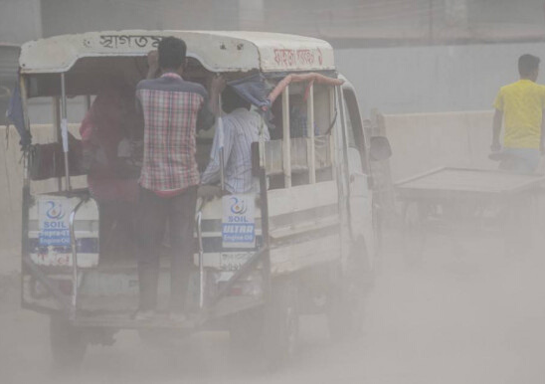
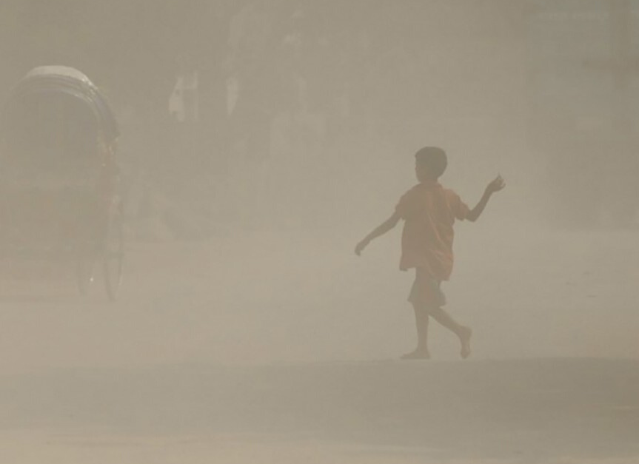
MOTIVATION

Slide 6
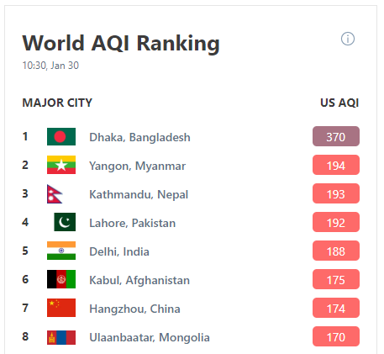
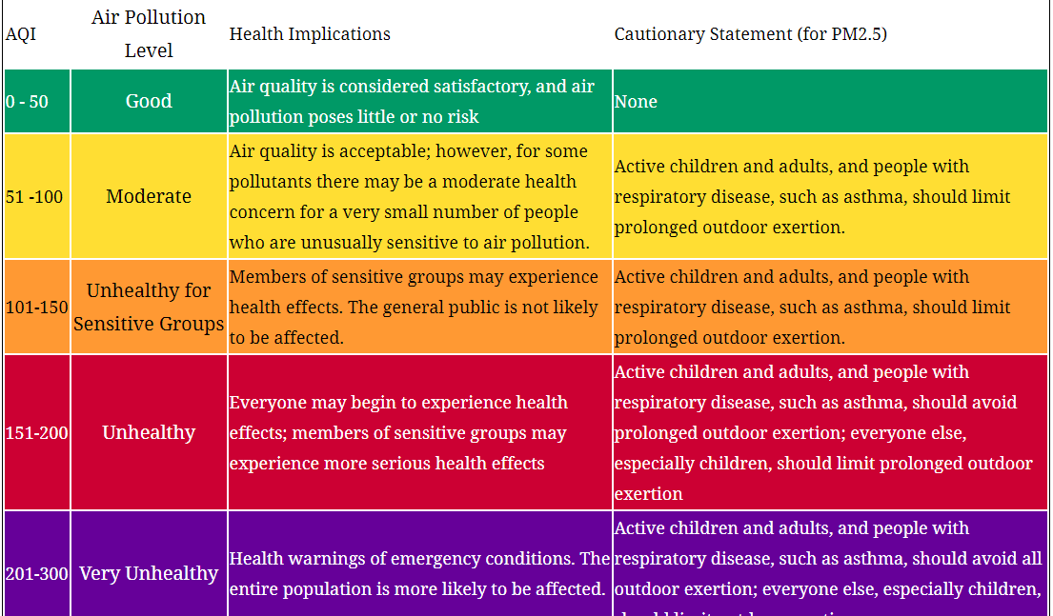
MOTIVATION
Figure: 2020 World ranking

Slide 7





WHY DRONE?
Drones are easy to control for remote sensing.
Drones are very stable devices.

Slide 8
THE POLLUTANTS CONTRIBUTING TO AIR POLLUTION
Particulate matter (PM10)
Particulate matter (PM2.5)
Carbon dioxide (CO2)
Carbon monoxide (CO)
Nitrogen oxides (NOX)
Sulfur dioxide (SO2)
Ozone (O3)

Slide 9


Gas Detector Sensors:
MQ 2
MQ 7
MQ135
Dust Detector Sensors:
PM 2.5
PM10
Gas Detector Sensors:
MQ 2
MQ 7
MQ135
Dust Detector Sensors:
PM 2.5
PM10
POLLUTION DETECTOR SENSORS
POLLUTION DETECTOR SENSORS

Slide 10
Why Our Drone Is Unique?
Can fly from a selected area and can get back to the same place.
No need for manual help.
Detecting pollutants within short time.
Give preliminary streaming result.

Slide 11





The Stages of Work till 499A
Research and Theoretical analysis
Selected Drone frame &
made DRONE
Integrated with GPS
01
02
03
Come up with an educated guess based on our research.
Selected topic & other sensors, components.
Reviewing literature related to topic.
Flying OF DRONE
Finalizing circuit for pollutants detection
05
Calibration of Drone with a controller & used Liberpilot to calibrate.
04
.

Slide 12

01
ARDUINO UNO
Arduino IDE for coding
02
INTEGRATION OF ALL SENSORS WITH ARDUINO
Data wii received from sensors to arduino.
Workflow for 499B
03
RASPBERRY PI WITH PI CAM
Serial communication between arduino uno and raspberry pi.
04
SERVER
opencv/ tensorflow
05
Interpret the results and analysing the data through an app or web.
DESKTOP CLIENT

Slide 13
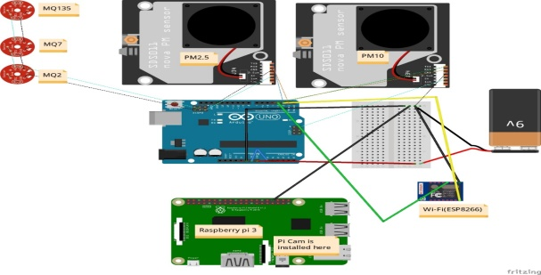
Circuit Diagram (sensors)
Gas Sensors:
MQ135:
MQ7:
MQ2:
Particulate Matter (PM) Sensor:
PM2.5
PM10
Other Components:
Arduino Uno R3
The Raspberry Pi
Pi Cam
Wi-Fi Module
9V battery

Slide 14
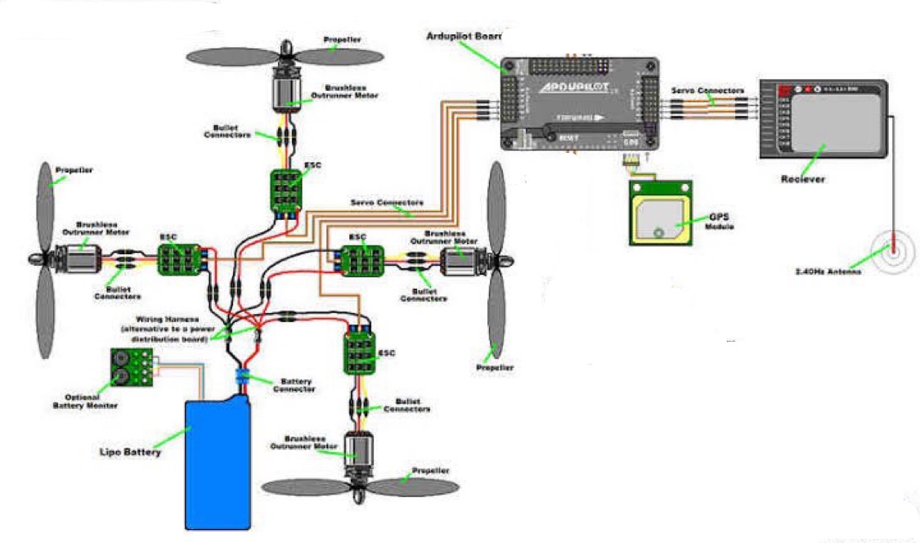
Schematic Diagram ( Drone)
Brushless Motor for Drone
ESC
Ardupilot APM 2.8
GPS- Neo-7
Lipo Battery 2200mAh / 11.1V
CT6B Remote Control
DJI F450 Frame

Slide 15

Complete Drone
Difficulties
Challenges
Steps
Practical Issues

Slide 16
Conclusion
Financial issues
Future Work
practical data
Air Filtration With Hepa Mini
statistical graph
health issues
Conclusion

Slide 17
You can also check our works by clicking the following link:
https://github.com/Meratun/Drone-project
Thank you

